Slide 1
CSS
Yvette Gottschalk

Slide 2
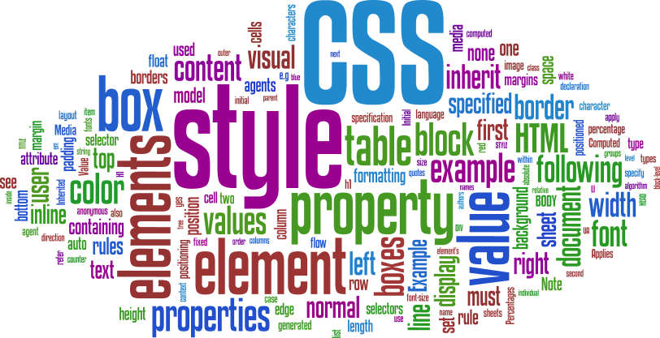
What is CSS
Cascading Style Sheets
CSS handles the look and feel part of a web page to make it presentable.
The World Wide Web Consortium (W3C) created CSS
Notes:
The World Wide Web Consortium, or W3C is a group that makes recommendations about how the Internet works and how it should evolve.
CSS was invited by Håkon Wium Lie on October 10, 1994

Slide 3

Why? (To put cats on the interwebz)

Slide 4
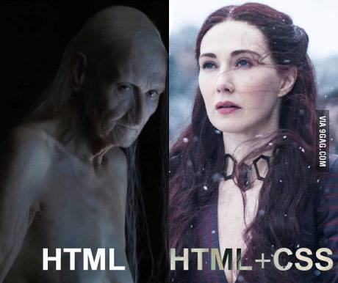


Slide 5
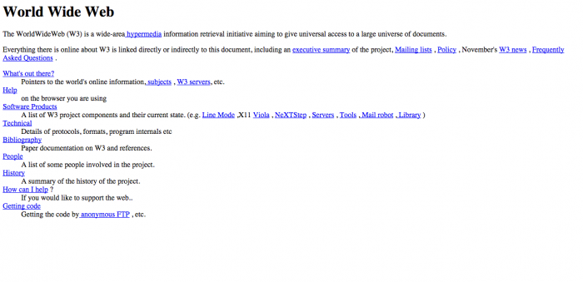
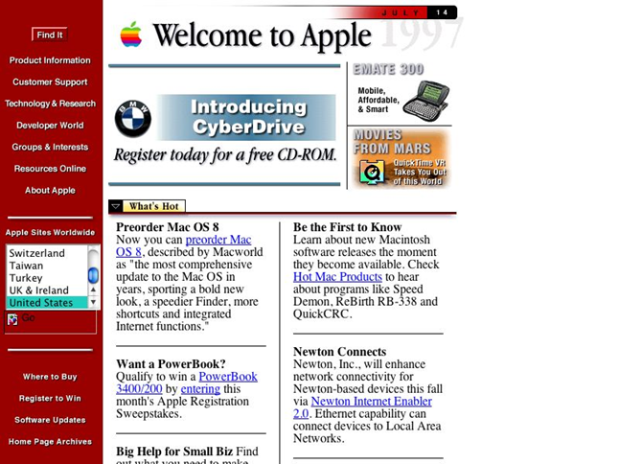
Notes:
December 1996 – CSS 1
May 1998 – CSS 2
June 2011 – CSS 2.1

Slide 6



Slide 7
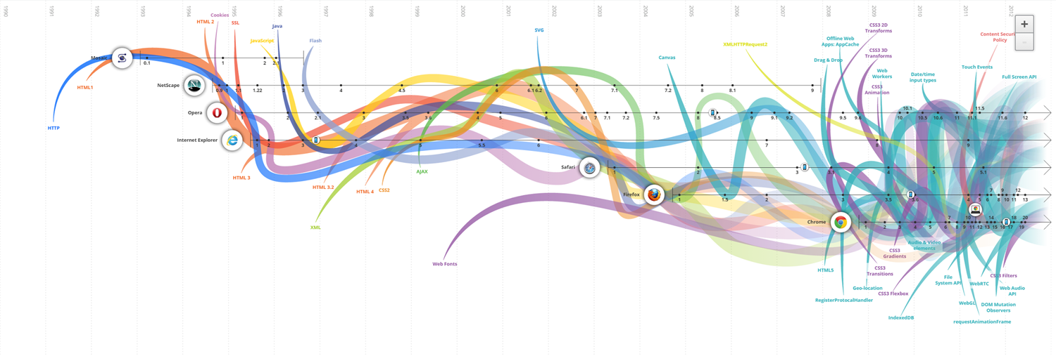
http://www.evolutionoftheweb.com/
Notes:
http://www.evolutionoftheweb.com/

Slide 8
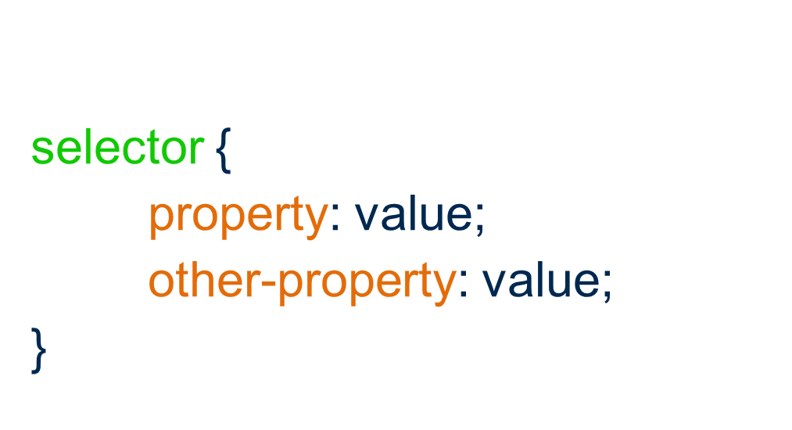
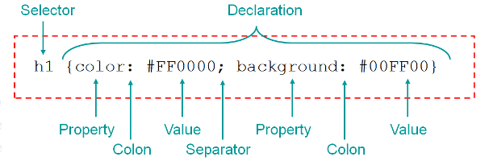
Rule Syntax

Slide 9
Adding CSS
Inline
Internal
In the html file as a separate element meta element.
External
In a separate file all together.

Slide 10
Inline CSS
<p style=”margin-left: 10px; color: #000000”>
Welcome to the dark side
</p>

Slide 11
Internal CSS
<style type=”text/css”>
p {
margin-left: 10px;
color: #000000;
}
</style>
<p>
We’ve got cookies
</p>

Slide 12
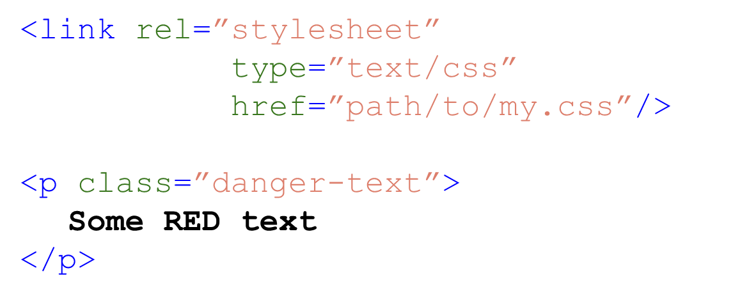
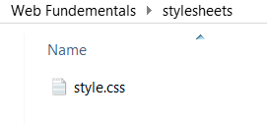
External CSS
Notes:
Explain order of precedence

Slide 13
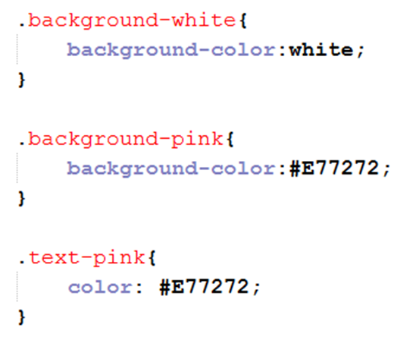
Specifying colours
a valid color name for example blue
an RGB value like rgb(0, 0, 250)
a HEX value like #0000FF
http://htmlcolorcodes.com/

Slide 14
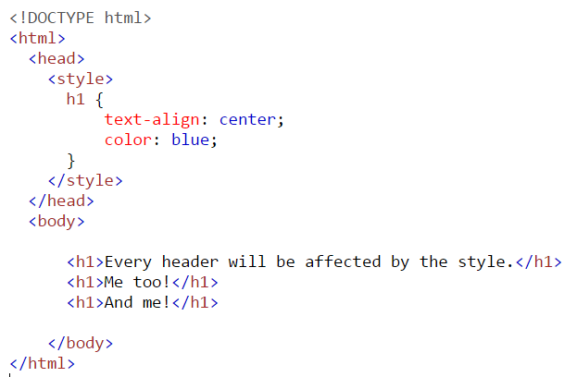
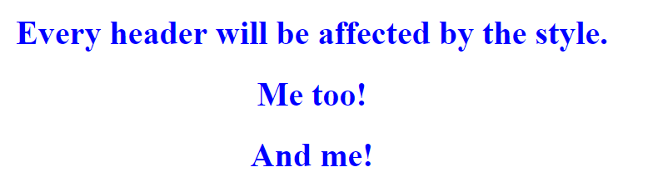
Element Selector

Slide 15
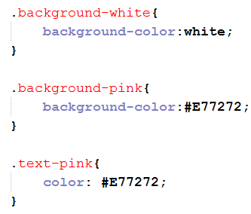
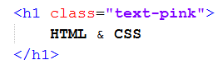

Class selector

Slide 16

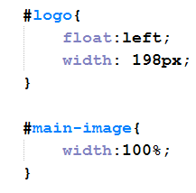
ID Selector

Slide 17
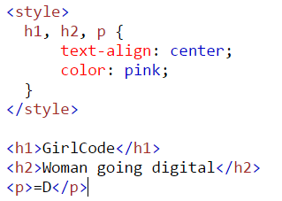

Grouping selectors

Slide 18
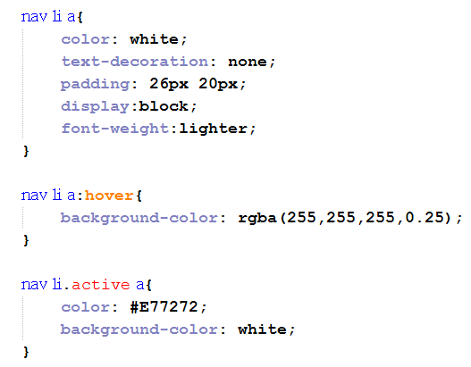
Styling links
a:link - a normal, unvisited link
a:visited - a link the user has visited
a:hover - a link when the user mouses over it
a:active - a link the moment it is clicked

Slide 19
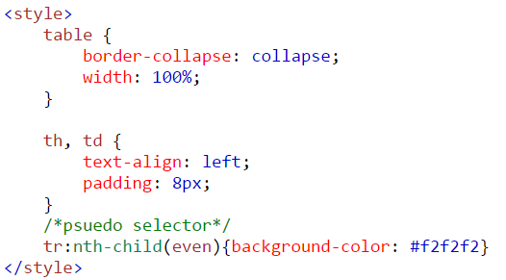
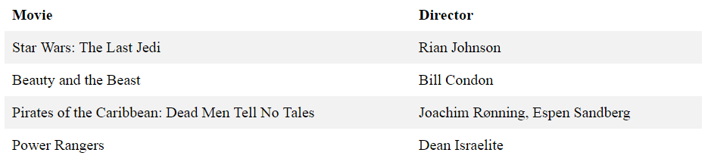
Styling tables

Slide 20
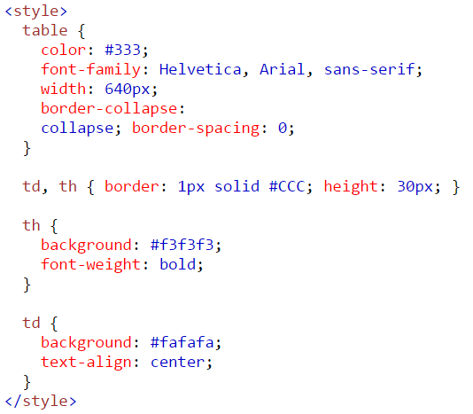

More table styles

Slide 21
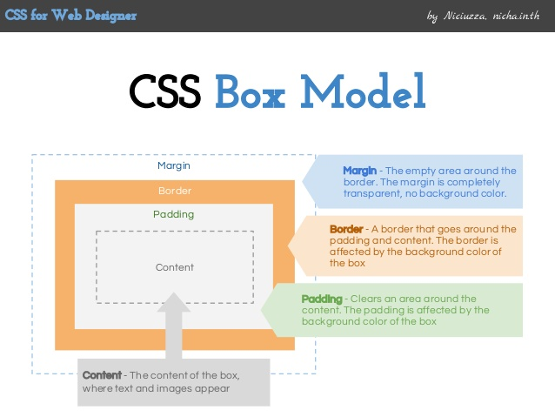
CSS Box Model

Slide 22
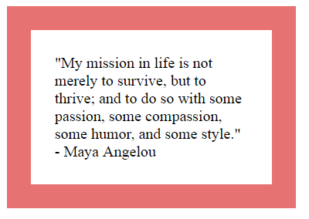
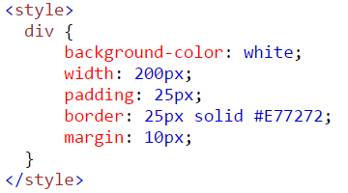
Box Model Example
Notes:
https://www.w3schools.com/code/tryit.asp?filename=FCZTWD54NWC3

Slide 23
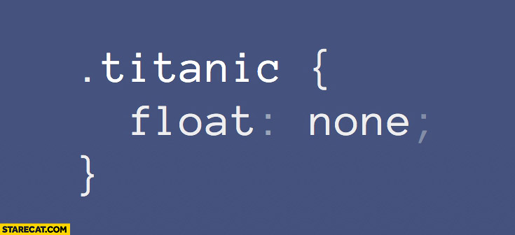
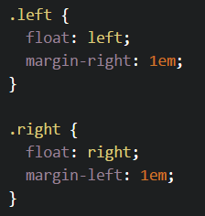
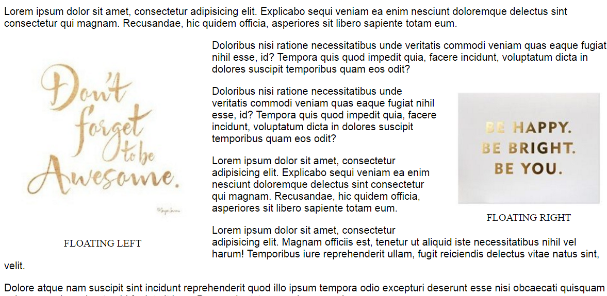
Float
Notes:
https://css-tricks.com/almanac/properties/f/float/

Slide 24
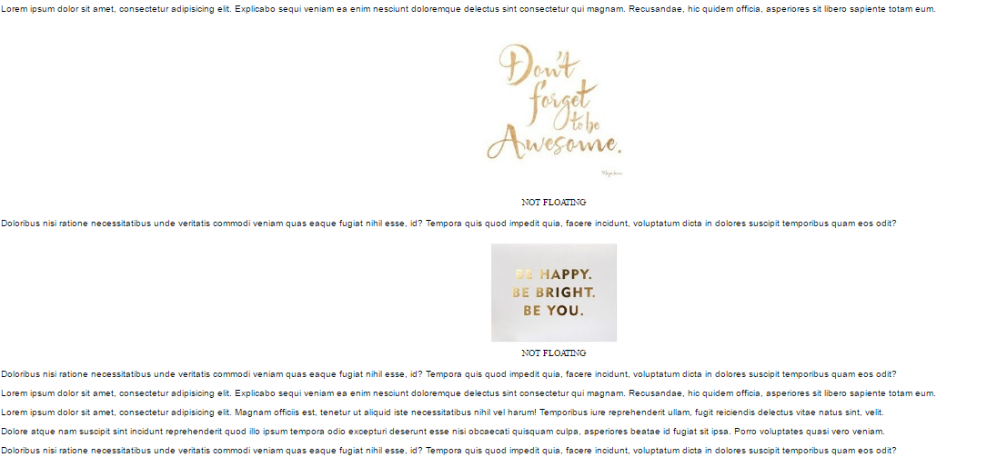
Without float

Slide 25

Separate Content from Style
Bad Code
<p style=”color: #939; font-size: 24px;”>
Thank you!
</p>

Slide 26

Separate Content from Style
Good Code
<style>
.alert-success {
color: #393;
font-size: 24px;
}
</style>
<p class=”alert-success”>
Thank you!
</p>

Slide 27
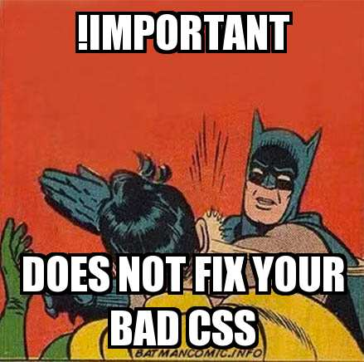
Do NOT use !important
!important overrides that particular property.
Code becomes messy and difficult to maintain
<style>
p {
color: red !important;
}
#greenParagraph {
color: green;
}
</style>
<p id=”greenParagraph”>
This will be red
</p>

Slide 28
CSS Frameworks
In the world of web design, a framework is defined as a package made up of a structure of files and folders of standardized code (HTML, CSS, etc.) which can be used to support the development of websites, as a basis to start building a site.
Examples:
Bootstrap - http://getbootstrap.com/
Skeleton
Foundation
Material Design Lite
Many many more...

Slide 29
CSS3
Animations and Transitions
Calculating values
Advanced selectors
Gradients
Webfonts
Boxsizing
Media queries
Border images
Transforms
http://www.creativebloq.com/css3/animation-with-css3-712437

Slide 30
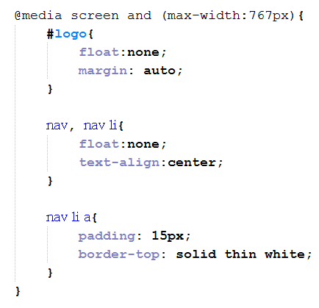
Media Queries
@media can include a media type followed by one or more expressions.
Common media types:
all
screen
print
tv
braille
The HTML5 specification includes new media types like 3d-glasses.
Should a media type not be specified the media query will use the screen media type by default

Slide 31
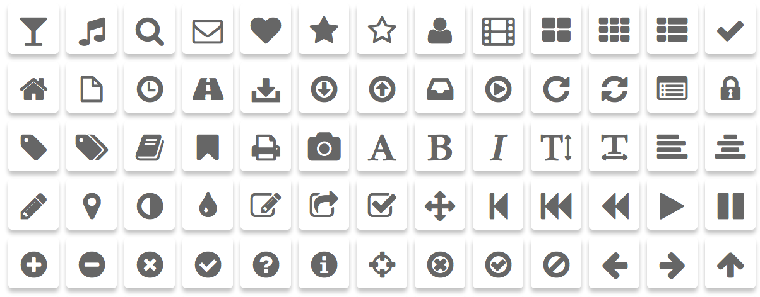
Icons
http://fontawesome.io/
http://glyphicons.com/

Slide 32
Reading Material
https://css-tricks.com/
https://www.codecademy.com/en/tracks/htmlcss
https://www.tutorialspoint.com/css/
https://www.w3schools.com/css/
http://learn.shayhowe.com/advanced-html-css/responsive-web-design/

